Slide 1

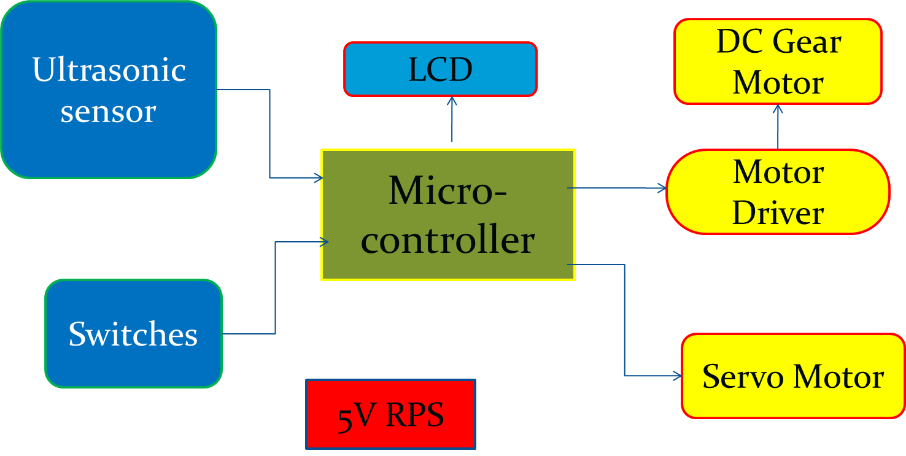
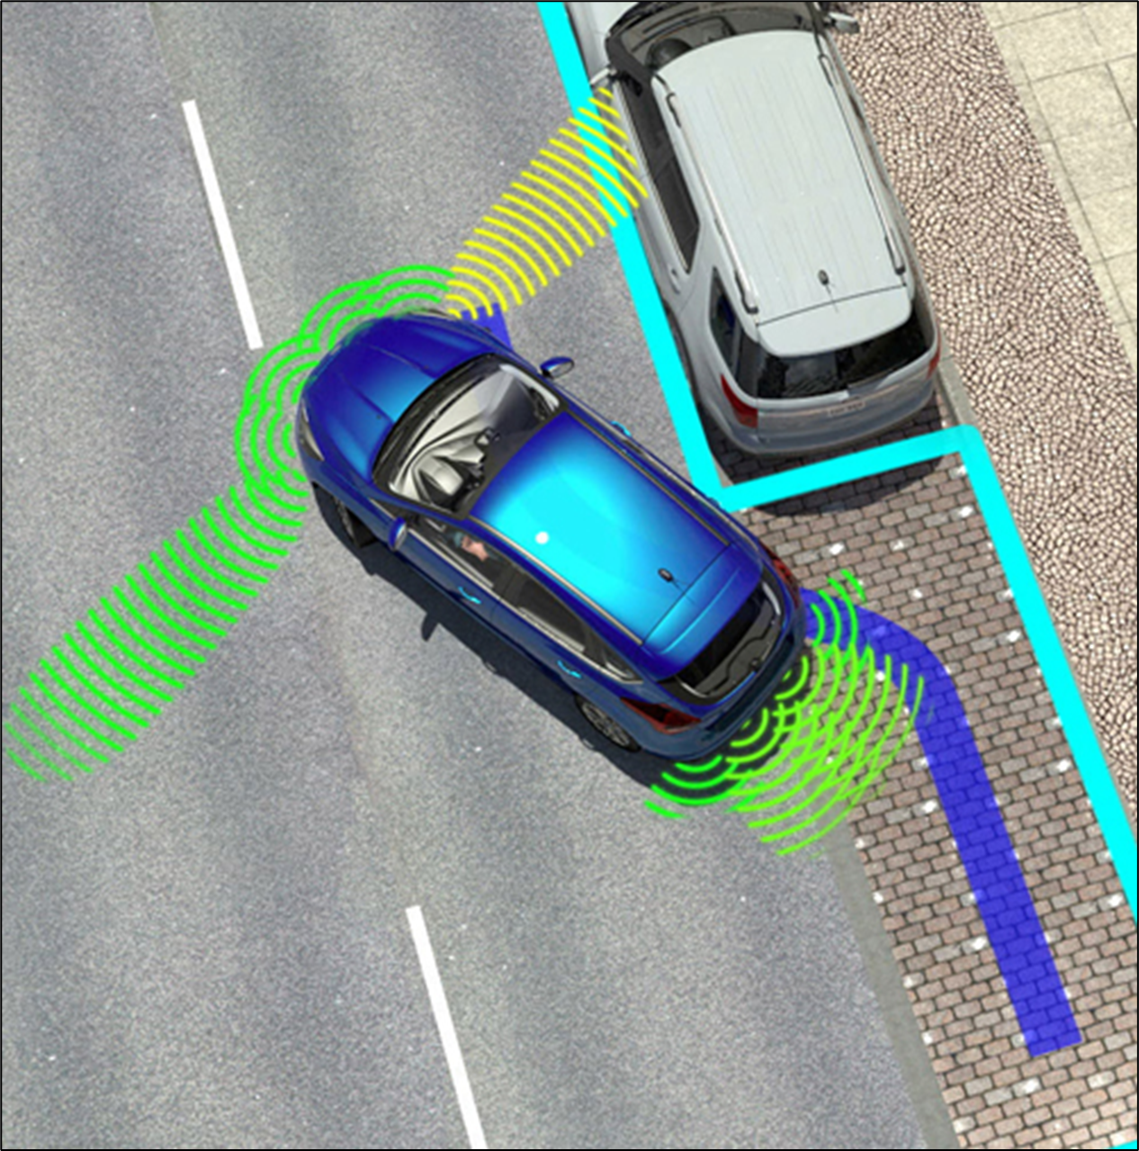
Smt. Kashibai Navale College of Engineering, Pune – 41.
Department of Electronics &Telecommunication Engineering
AUTONOMOUS VEHICLE PARKING USING NEURO FUZZY LOGIC
GROUP NO:-
A23
Introduction
In this modern world, parking of vehicles has major issue in the world. Because population is growing drastically which indirectly reduces the space available for parking. Due to this high population, traffic congestion problems have become a major issue in today’s world. So it is a need to solve the parking problems and provide an efficient solution for parking of the vehicles. Advanced Car Parking is an efficient solution for traffic congestion. The design of this system in which the parking has no intervention of human at all. This system has not only reduces the human efforts, but also reduces the consumption of space.
Advantages
Greater sense of security.
Less chances for vehicle vandalism.
Efficient utilization of parking space.
Less time utilized for parking.
Reduces Human efforts
Block Diagram
Applications
• Parking system.
• Shopping Mall.
• Automatic cars.
Conclusion
Thus we have focused on the most difficult case of parallel parking which is the case when the parking space dimensions cannot be identified. We are reducing the time to park the Car and save the fuel.
This type of technology could be implemented in Self -Driving car in which most of the functionalities would be Autonomous
Objectives
To scan the Parking space and verify the distance.
To adjust the position of vehicle for parking.
To start the parking algorithm and get the vehicle parked.
To un-park the vehicle safely
GUIDE:PROF.V.R.WAGHMARE

